Slide 1

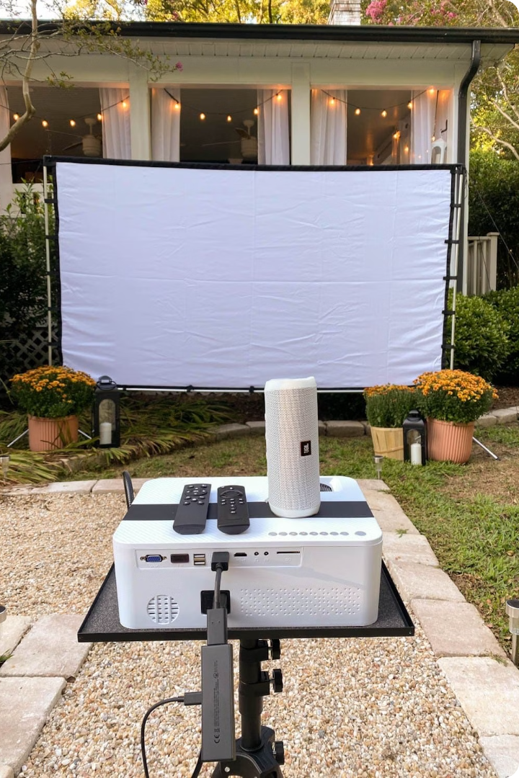

Portable Movie Screens: A New Era of Entertainment
Welcome to the future of portable entertainment! Imagine a movie night under the stars, a captivating presentation in a conference room, or a thrilling gaming session on the go. These possibilities are now within reach with the advent of innovative portable movie screens.

Slide 2

Compact and Lightweight Design
Gone are the days of bulky and cumbersome screens. Portable movie screens are designed to be compact, foldable, and lightweight. This makes them easy to transport and set up anywhere.
Easy Setup
Space-Saving
Portable screens typically feature simple assembly mechanisms and come with a carrying case for convenience.
Their compact size allows them to be stored easily in a closet or travel bag when not in use.

Slide 3
High-Quality Display Resolution
Experience the sharpness and clarity of your favorite movies and videos with high-resolution portable screens. These screens boast vibrant colors, sharp images, and exceptional detail.
Full HD and 4K Resolutions
Wide Viewing Angles
Many portable screens support Full HD (1080p) and even 4K resolutions, delivering an immersive viewing experience.
Ensure everyone in the room gets a great view with wide viewing angles that minimize distortion and maintain picture quality.

Slide 4




Versatile Mounting Options
Portable screens come with versatile mounting options to suit any environment. These options provide flexibility in positioning the screen for optimal viewing.
Tripod Stands
A common mounting method, tripod stands provide stability and adjustability for outdoor and indoor use.
Wall Mounts
For permanent installations, wall mounts offer a secure and space-saving option, ensuring a seamless integration with the room.
Ceiling Mounts
Create a cinematic experience by hanging the screen from the ceiling, maximizing space and providing an immersive viewing experience.

Slide 5

Immersive Viewing Experience
Immerse yourself in the world of your favorite films and shows with portable movie screens designed to enhance the viewing experience.
1
Large Screen Sizes
2
Anti-Glare Coatings
Portable screens are available in various sizes, from compact options to large screens that create a cinematic feel.
Anti-glare coatings minimize reflections, ensuring a clear and comfortable viewing experience, even in bright environments.
3
High Contrast Ratio
High contrast ratio screens provide deep blacks and vibrant whites, enhancing the overall picture quality and creating a more realistic image.

Slide 6
Innovative Screen Materials
Modern portable movie screens are made with innovative materials designed to deliver superior picture quality and durability.
Material
Features
Fiber Optic Fabric
Provides high contrast and vivid colors for an enhanced viewing experience.
Micro-Perforated Fabric
Minimizes sound distortion and allows for airflow, reducing wrinkles and ensuring a smooth viewing surface.
High-Density Material
Enhances light reflection and minimizes light scattering, resulting in sharper and clearer images.

Slide 7



Connectivity and Compatibility
Portable movie screens are designed to be compatible with a wide range of devices, ensuring easy connectivity and seamless integration into any setup.
HDMI
USB
Bluetooth
Standard HDMI connectivity allows for easy connection to laptops, smartphones, and other devices.
Some screens offer USB ports for connecting external devices and powering the screen.
Bluetooth capabilities allow for wireless streaming from devices like smartphones and tablets.

Slide 8

Conclusion: The Future of Portable Screens
Portable movie screens are transforming the way we experience entertainment. Their compact design, high-quality display, and versatile features cater to a variety of needs, from casual home movie nights to professional presentations.
Portable Entertainment Hubs
Advanced Materials
The future of portable screens may involve the integration of audio systems, speakers, and lighting, creating a complete entertainment hub.
Expect further advancements in screen materials, offering even brighter, clearer, and more durable viewing experiences.
1
2
3
Integration with Smart Devices
The integration of smart devices will allow for seamless control, voice commands, and personalized viewing settings.

